Slide 1





Machine Learning, Deep Learning and it's Applications
15 Days Internship Program
POORNIMA COLLEGE OF ENGINEERING

Slide 2





LEARNINGS OF THE TRAINING
INTRODUCTION TO IMAGE PROCESSING
INTRODUCTION TO PYTHON AND ITS LIBRARIES
INTRODUCTION TO MACHINE LEARNING
SUPERVISED LEARNING-REGRESSION AND CLASSIFICATION
UNSUPERVISED LEARNING
INTRODUCTION TO DEEP LEARNING
MODEL DEVELOPMENT USING ANN AND CNN FRAMEWORKS
GUEST LECTURES BY EMINENT ACADEMICIANS AND INDUSTRY EXPERTS.

Slide 3






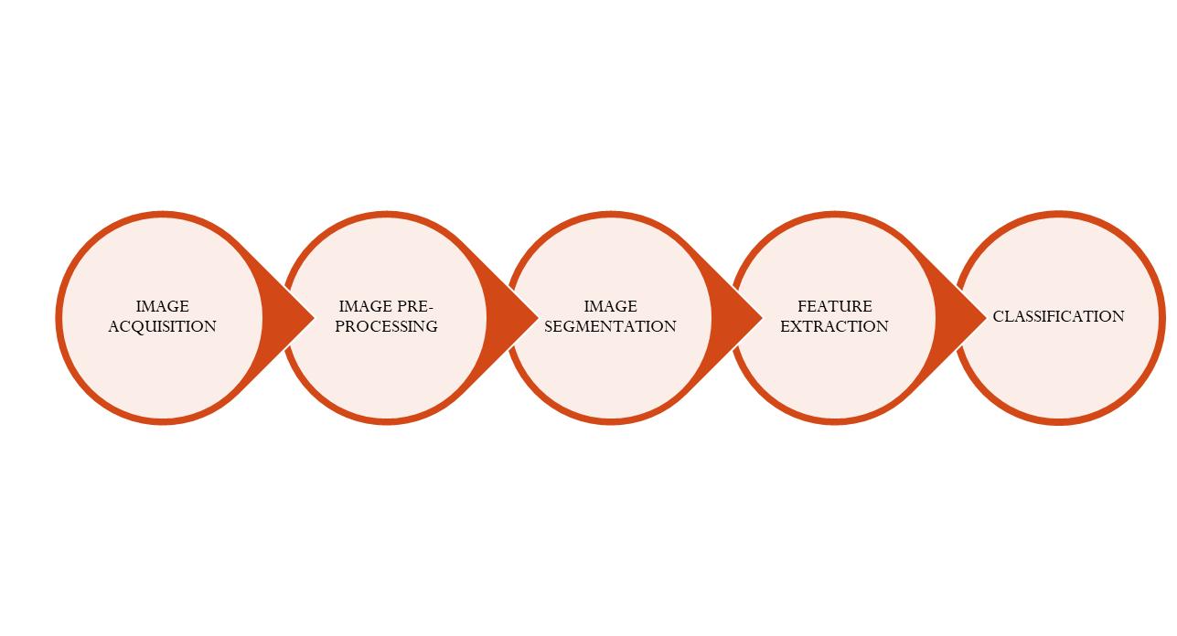


IMAGE PROCESSING
Digital Image Processing is concerned with acquiring and processing of an image by means of a digital computer.

Slide 4




INTRODUCTION TO PYTHON AND ITS LIBRARIES
Python is a high-level, interpreted, general-purpose programming language. Its design philosophy emphasizes code readability with the use of significant indentation.
Python is the most widely used language for machine learning and deep learning concepts
LIBRARIES used in Python for machine learning and deep learning are : Pandas, Numpy, Matplotlib, Sklearn, Tensor-Flow and Keras Api

Slide 5
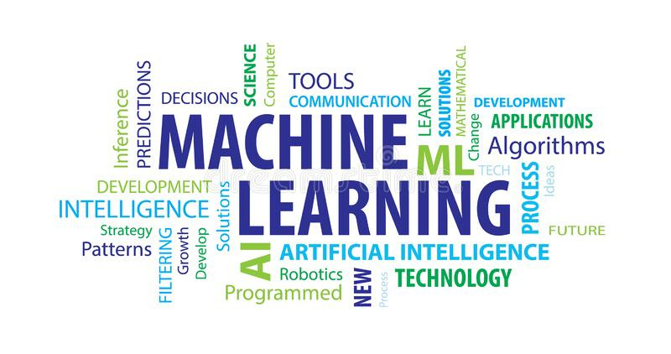

Machine Learning is a field of study that gives computers the capability to learn without being explicitly programmed”.

Slide 6
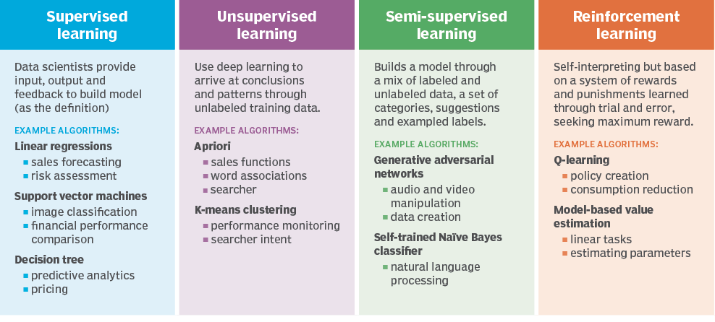
TYPES OF MACHINE LEARNING
.

Slide 7

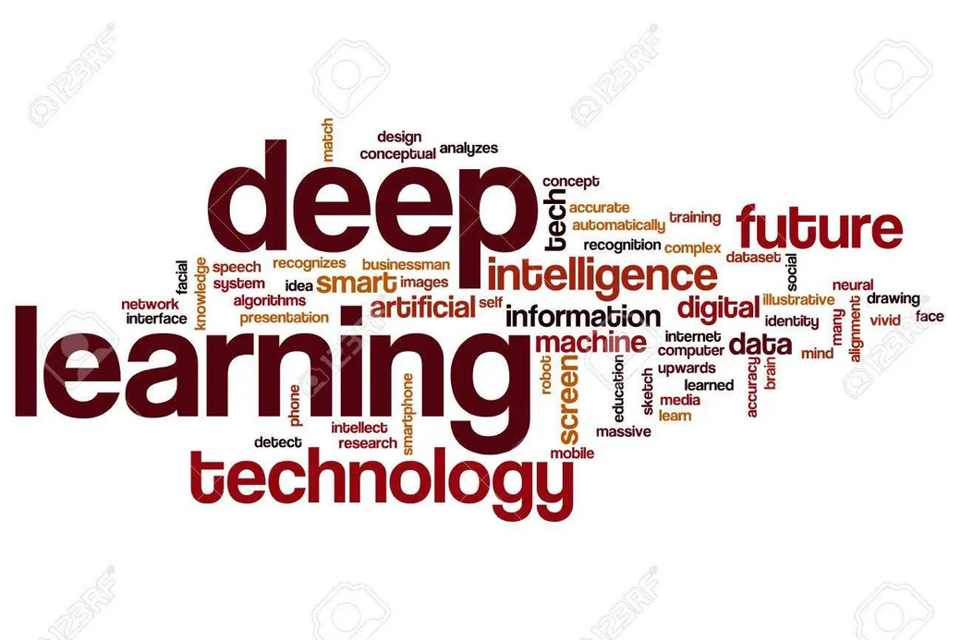
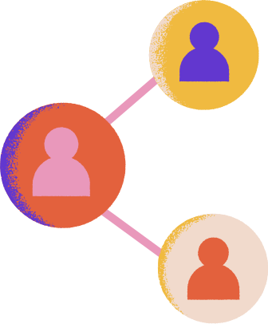
DEEP LEARNING
Deep learning is part of a broader family of machine learning methods based on artificial neural networks with representation learning. Learning can be supervised, semi-supervised or unsupervised.

Slide 8


TYPES OF DEEP LEARNING
ARTIFICIAL NEURAL NETWORK

Slide 9
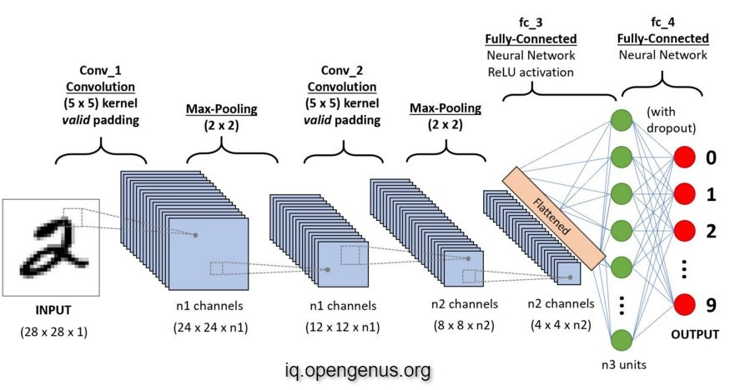
TYPES OF DEEP LEARNING
CONVOLUTIONAL NEURAL NETWORK

Slide 10
PROJECT DEMONSTRATION ON CLASSIFYING MNIST DATA-SET USING ANN ALGORITHM

Slide 11
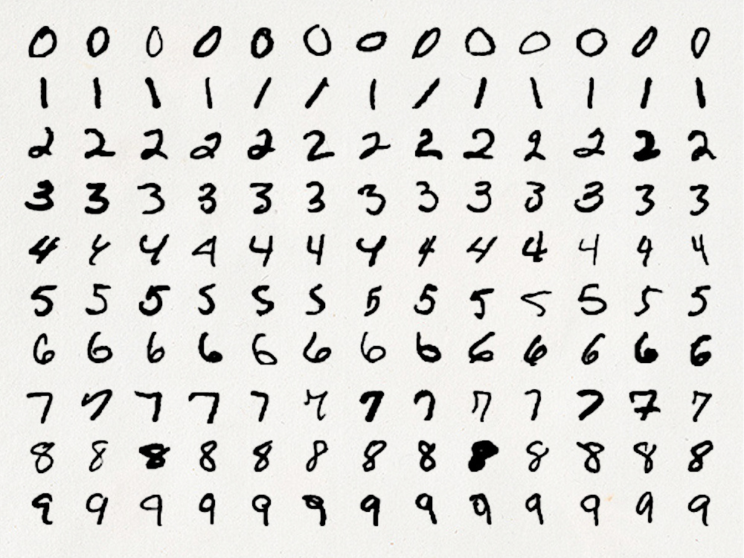

MNIST DATA-SET
The MNIST dataset is an acronym that stands for the Modified National Institute of Standards and Technology dataset. It is a dataset of 70,000 small square 28×28 pixel grayscale images of handwritten single digits between 0 and 9..

Slide 12
THANK YOU

